Slide 1
Lecture 7 上机 多分类回归

Slide 2
Multinomial logistic regression
Let j=1 denote the reference category
Fit separate logistic regression models for j=2,…, L, comparing each outcome to the baseline:
Note that this will result in L-1 vectors of regression coefficients (we don’t need to estimate the Lth vector because

Slide 3
Data
Entering high school students make program choices
Y: choose from general program, vocational program and academic program.
X: writing score
social economic status.

Slide 4
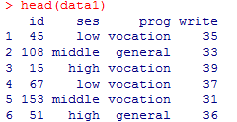
Read in the dataset
data1=read.csv("E:/数据分析和统计软件/Lecture 7 上机数据/data1.csv", header=T, sep=',')
The data set contains variables on 200 students. The outcome variable is prog, program type. The predictor variables are social economic status, ses, a three-level categorical variable and writing score, write, a continuous variable.

Slide 5


Descriptive statistics
with(data1, table(ses, prog))
tapply(data1$write, data1$prog, mean)
tapply(data1$write, data1$prog, sd)

Slide 6
Build multinomial logistic regression model
library(nnet)
data1$prog2 <- relevel(data1$prog, ref = "academic")
data1$ses2 <- relevel(data1$ses, ref = "low")
test <- multinom(prog2 ~ ses2 + write, data = data1)
summary(test)

Slide 7
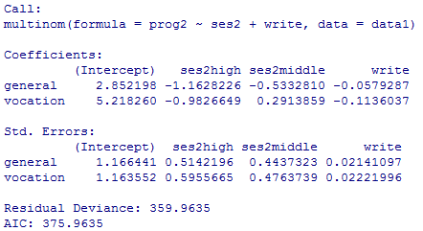
A one-unit increase in write decreases the log odds of being in general program vs. academic program by 0.0579.
A one-unit increase in write decreases the log odds of being in vocation program vs. academic program by 0.1136.
The log odds of being in general program than in academic program will decrease by 1.163 if moving from ses=”low” to ses=”high”.
On the other hand, Log odds of being in general program than in academic program will decrease by 0.5332 if moving from ses=”low” to ses=”middle”.
The log odds of being in vocation program vs. in academic program will decrease by 0.983 if moving from ses=”low” to ses=”high”.
The log odds of being in vocation program vs. in academic program will increase by 0.291 if moving from ses=”low” to ses=”middle”.

Slide 8
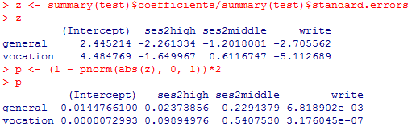
Calculate Z score and p-Value
z <- summary(test)$coefficients/summary(test)$standard.errors
z
p <- (1 - pnorm(abs(z), 0, 1))*2
P

Slide 9
#transform the log odds to odds
exp(coef(test))
# predicted probabilities
pp=fitted(test)

Slide 10

Explore the relationship between prog and ses, holding write constant
Holding write at its mean and examining the predicted probabilities for each level of ses
dses <- data.frame(ses2= c("low", "middle", "high"), write = mean(data1$write))
predict(test, newdata = dses, "probs")

Slide 11
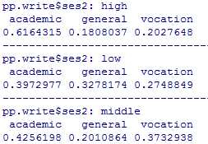
Explore the relationship between prog and write, holding ses constant
Compute the averaged predicted probabilities for different values of the continuous predictor variable write within each level of ses.
dwrite <- data.frame(ses2 = rep(c("low", "middle", "high"), each = 41), write = rep(c(30:70), 3))
dwrite
pp.write <- cbind(dwrite, predict(test, newdata = dwrite, type = "probs"))
by(pp.write[, 3:5], pp.write$ses2, colMeans)

Slide 12
Plot the predicted probabilities against write by ses for different levels of prog
# melt data set to long
library(reshape2)
lpp <- melt(pp.write, id.vars = c("ses2", "write"), value.name ="probability")
library(ggplot2)
ggplot(lpp, aes(x = write, y = probability, colour = ses2)) +geom_line() +facet_grid(variable ~ .)

Slide 14
Compare with the null model:
testnull <- polr(as.factor(apply2) ~ 1, data= data2)
summary(testnull)
anova(test, testnull)
Diagnostics: Unlike logistic regression where there are many statistics for performing model diagnostics, it is not as straightforward to do diagnostics with multinomial logistic regression models. For the purpose of detecting outliers or influential data points, one can run separate logit models and use the diagnostics tools on each model.
data12=data1[data1$prog!="vocation",]
data12$prog2 <- relevel(data12$prog, ref = "academic")
data12$ses2 <- relevel(data12$ses, ref = "low")
model2 <- glm(prog2 ~ ses2 + write, data=data12, family=binomial)
summary(model2)

Slide 15
Ordinal Logistic Regression
This is called the proportional odds model. It is based on the assumption that the effects of the covariates x₁,…,x_{p-1} are the same for all categories on the logarithmic scale. That is, the odds ratio for a one unit change in x is the same for all response categories.

Slide 16
Data
A study looks at factors that influence the decision of whether to apply to graduate school.
Y: College juniors are asked if they are unlikely, somewhat likely, or very likely to apply to graduate school. Hence, our outcome variable has three categories.
X: parental educational status,
whether the undergraduate institution is public or private,
current GPA

Slide 17
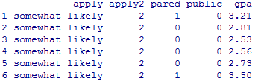
Read in the dataset
data2=read.csv("E:/数据分析和统计软件/Lecture 7 上机数据/data2.csv", header=T, sep=',')
The data set has a dependent variable known as apply. It has 3 levels namely “unlikely”, “somewhat likely”, and “very likely”, coded in 1, 2, and 3 respectively. 3 being highest and 1 being lowest. This situation is best for using ordinal regression because of presence of ordered categories.
Pared (0/1) refers to at least one parent has a graduate degree;
public (0/1) refers to the type of undergraduate institute.

Slide 18
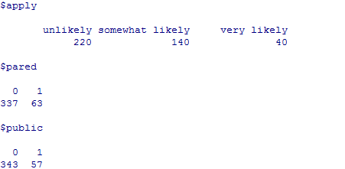

Descriptive statistics
lapply(dat[, c("apply", "pared", "public")], table)
summary(data2$gpa)
sd(data2$gpa)

Slide 19
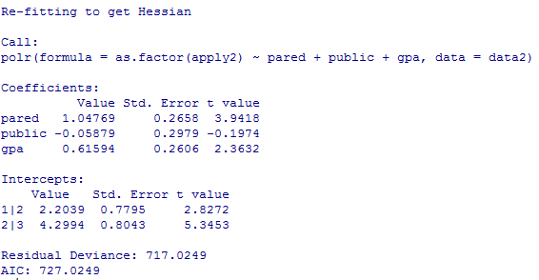
Build ordinal logistic regression model
library(MASS)
test2 <- polr(as.factor(apply2) ~ pared + public + gpa, data= data2)
summary(test2)

Slide 20
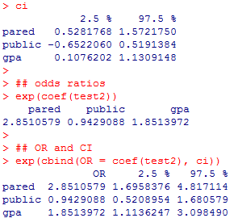
Significant or not
#CI
ci=confint(test2)
ci
# Odds Ratios (OR)
exp(coef(test2))
# OR and CI
exp(cbind(OR = coef(test2), ci))

Slide 21
Odds ratios
The estimates in the output are given in units of ordered logits, or ordered log odds.
For pared, we would say that for a one unit increase in parental education, i.e., going from 0 (Low) to 1 (High), the odds of "very likely" applying versus "somewhat likely" or "unlikely" applying combined are 2.85 greater, given that all of the other variables in the model are held constant.
Likewise, the odds "very likely" or "somewhat likely" applying versus "unlikely" applying is 2.85 times greater, given that all of the other variables in the model are held constant.
For gpa (and other continuous variables), the interpretation is that when a student's gpa moves 1 unit, the odds of moving from "unlikely" applying to "somewhat likely" or "very likley" applying (or from the lower and middle categories to the high category) are multiplied by 1.85.

Slide 22
Plot the predicted probabilities against the gpa by pared and public for different levels of the outcome variable
range(data2$gpa)
newdata2 <- data.frame(
pared = rep(0:1, 200),
public = rep(0:1, each = 200),
gpa = rep(seq(from = 1.9, to = 4, length.out = 100), 4)
newdata2 <- cbind(newdata2, predict(test2, newdata2, type = "probs"))
#reshape the data long with the reshape2 package and plot all of the predicted probabilities for the different conditions
lnewdata2 <- melt(newdata2, id.vars = c("pared", "public", "gpa"), variable.name = "Level", value.name="Probability")
library(ggplot2)
ggplot(lnewdata2, aes(x = gpa, y = Probability, colour = Level)) + geom_line() + facet_grid(pared ~ public, labeller="label_both")

Slide 24
Comparing with null model
testnull <- polr(as.factor(apply2) ~ 1, data= data2)
summary(testnull)
anova(test2, testnull)
Comparing multinomial logistic regression model
test3 <- multinom(as.factor(apply2) ~ pared + public + gpa, data = data2)
summary(test3)
sapply(list(test2, test3), AIC)
[1] 727.0249 729.9940
Comparing with ordinal probit regression model
test4 <- polr(as.factor(apply2) ~ pared + public + gpa, method="probit", data= data2)
summary(test4)
anova(test2, test4)
Doing diagnostics for non-linear models is difficult, and ordered logit/probit models are even more difficult than binary models

